Slide 1

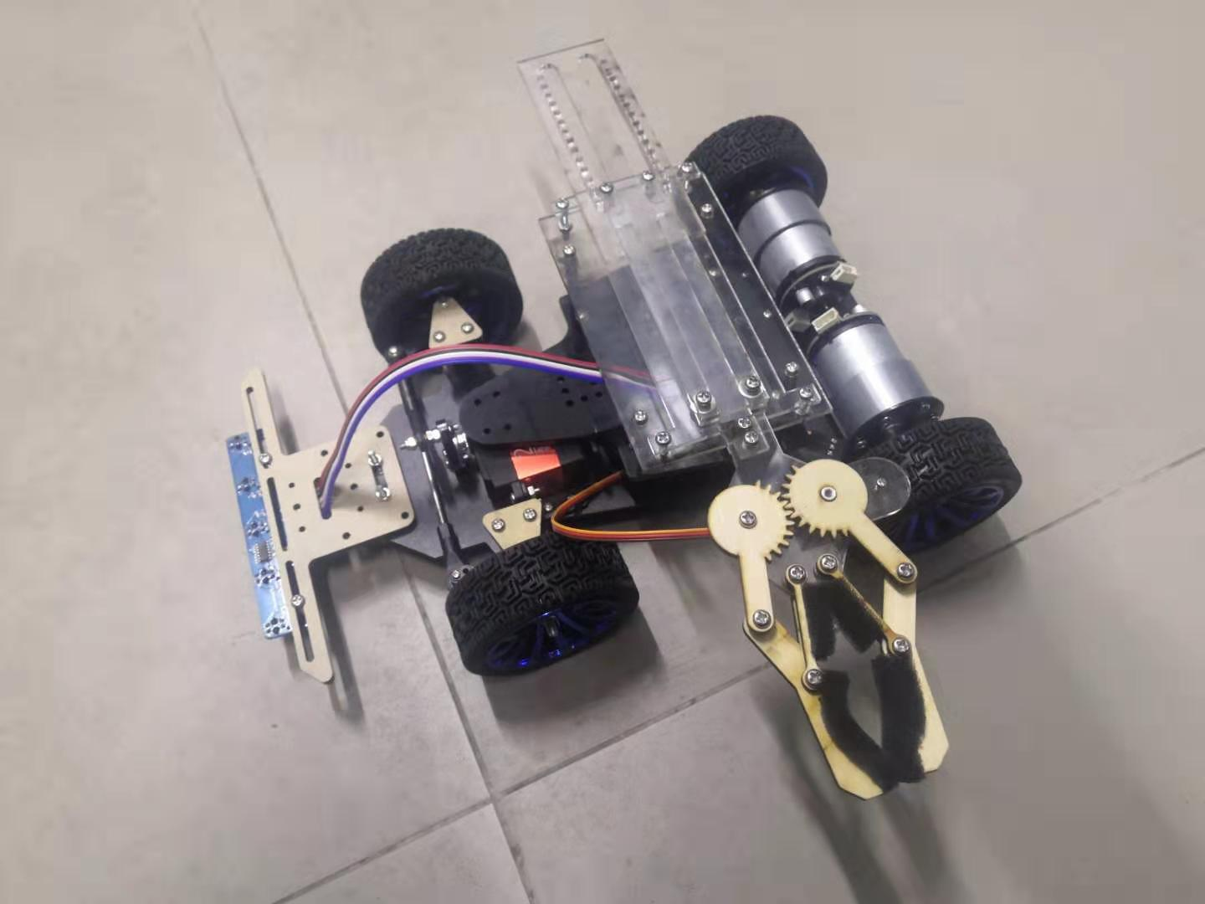





Highlights
Servo motor-controlled turning device
High accuracy tracking code
Gear-based mechanical arm
Five sensors for tracking line
ATLAS
Graphic

